Slide 1



Optimizing the System Design of a Differential 3rd Order Delta-Sigma (∆Σ) Modulator
M.Sc(s) Alex Julian Mantilla Rios
Integrated Systems Research Group – OnChip
Universidad Industrial de Santander, Bucaramanga - Colombia
alex2248086@correo.uis.edu.co

Slide 2
Outline
Delta-Sigma Modulator Context.
Simulink Modeling.
Optimization Results.

Slide 3
Outline
Delta-Sigma Modulator Context.
Simulink Modeling.
Optimization Results.

Slide 4
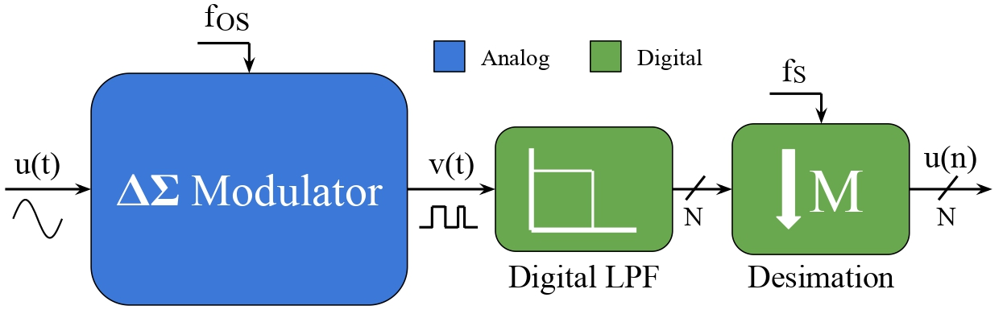
Delta-Sima Modulator

Slide 5
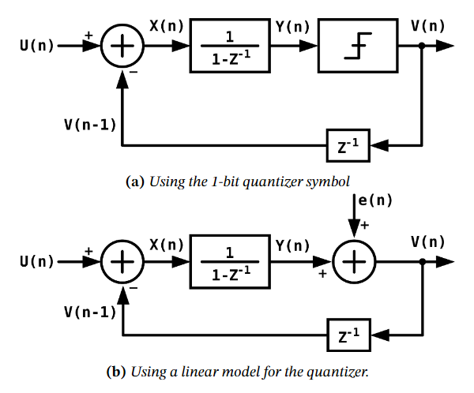
Modulator System Model
$$\text{V}\text{(}\text{z}\text{) = }\text{U}\text{(}\text{z}\text{) + (1 − }\text{z}\text{−1) ⋅ }\text{E}\text{(}\text{z}\text{)}$$
$$\text{V}\text{(}\text{z}\text{) = }\text{STF}\text{(}\text{z}\text{) ⋅ }\text{U}\text{(}\text{z}\text{) + }\text{NTF}\text{(}\text{z}\text{) ⋅ }\text{E}\text{(}\text{z}\text{)}$$

Slide 6
Modulator System Model
$$\text{V}\text{(}\text{z}\text{) = }\text{U}\text{(}\text{z}\text{) + (1 − }\text{z}\text{−1) ⋅ }\text{E}\text{(}\text{z}\text{)}$$
$$\text{V}\text{(}\text{z}\text{) = }\text{STF}\text{(}\text{z}\text{) ⋅ }\text{U}\text{(}\text{z}\text{) + }\text{NTF}\text{(}\text{z}\text{) ⋅ }\text{E}\text{(}\text{z}\text{)}$$
$$\text{STF}\text{(}\text{z}\text{) = 1}$$
$$\text{NTF}\text{(}\text{z}\text{) = (1 − }z^{−1}\text{)}$$

Slide 7
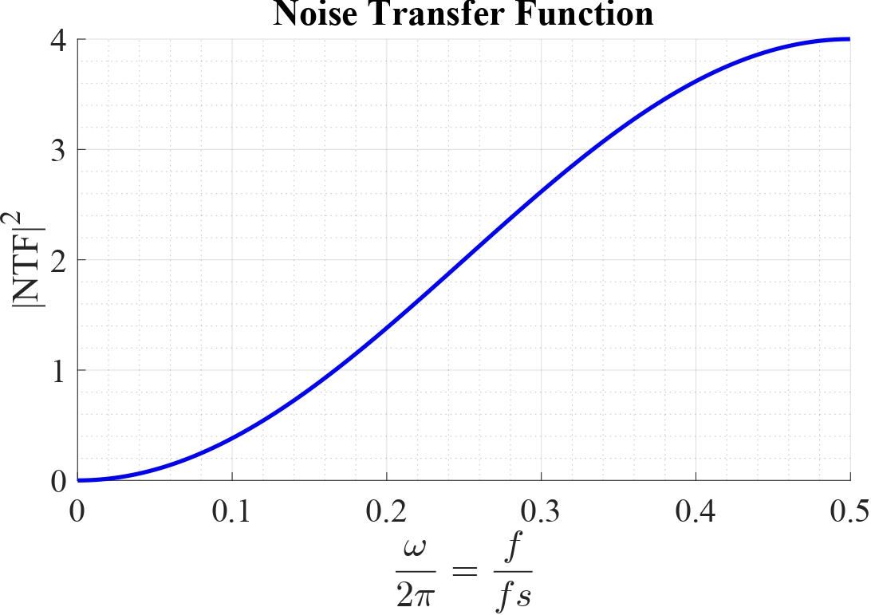
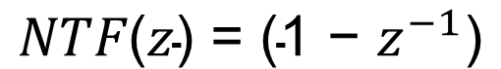
Noise Transfer Function
$$\text{NTF}\text{(}\text{z}\text{) = (1 − }z^{−1}\text{)}$$
Amplifying Quantization Noise
Attenuating
Quantization Noise

Slide 8
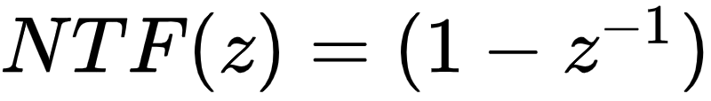
Noise Transfer Function
How is this useful?
Amplifying Quantization Noise
Attenuating
Quantization Noise

Slide 9
Noise Transfer Function
BW

Slide 10
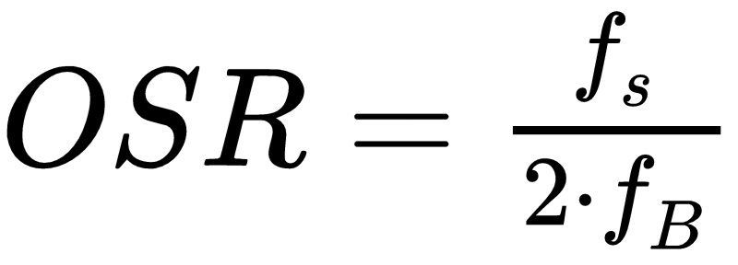
Noise Transfer Function
BW

Slide 11
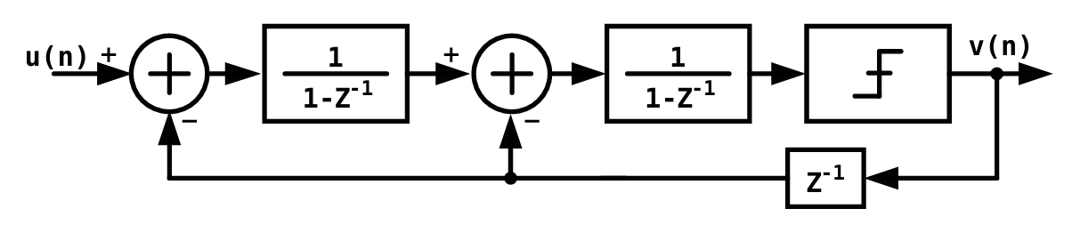
Higher Order Delta Sigma
$$\text{V}\text{(}\text{z}\text{) = }\text{U}\text{(}\text{z}\text{) +}{\text{(1 − }z^{−1}\text{)}}^{2}\text{⋅ }\text{E}\text{(}\text{z}\text{)}$$

Slide 12
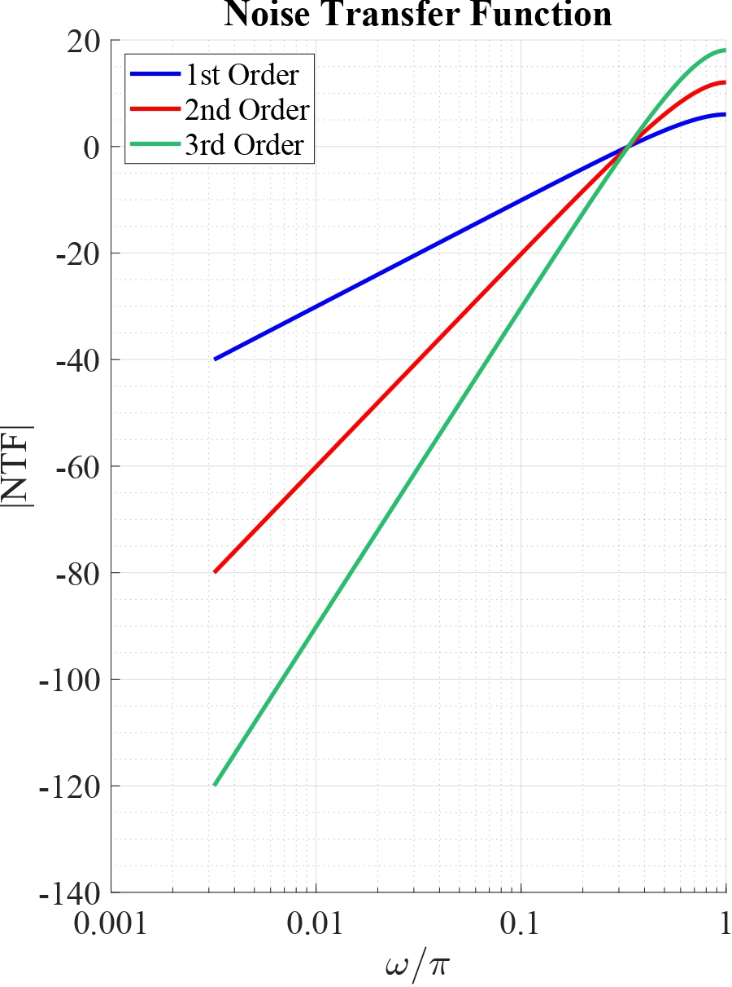
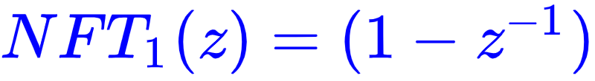
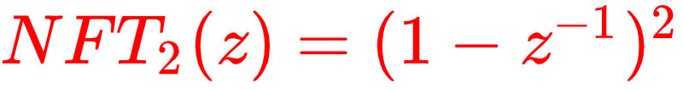
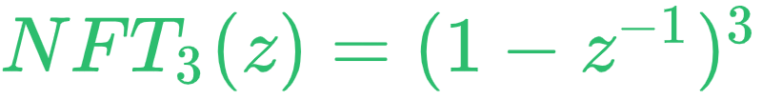
Higher Order Delta Sigma

Slide 13
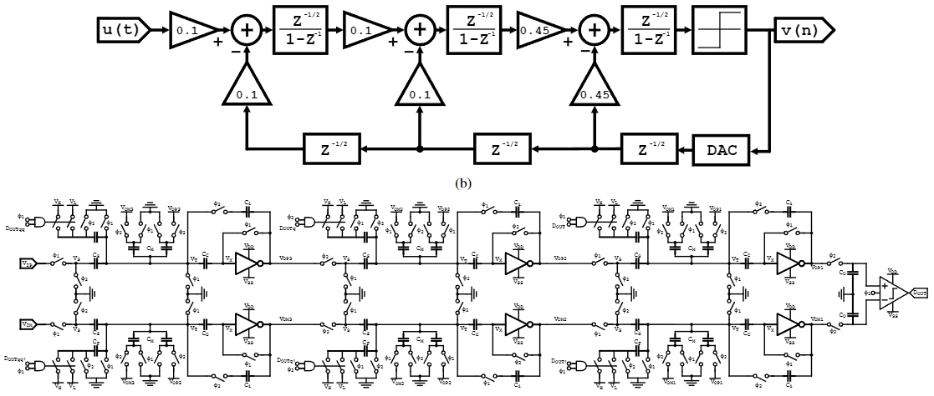
Higher Order Delta Sigma

Slide 14
Outline
Delta-Sigma Modulator Context.
Simulink Modeling.
Optimization Results.

Slide 15
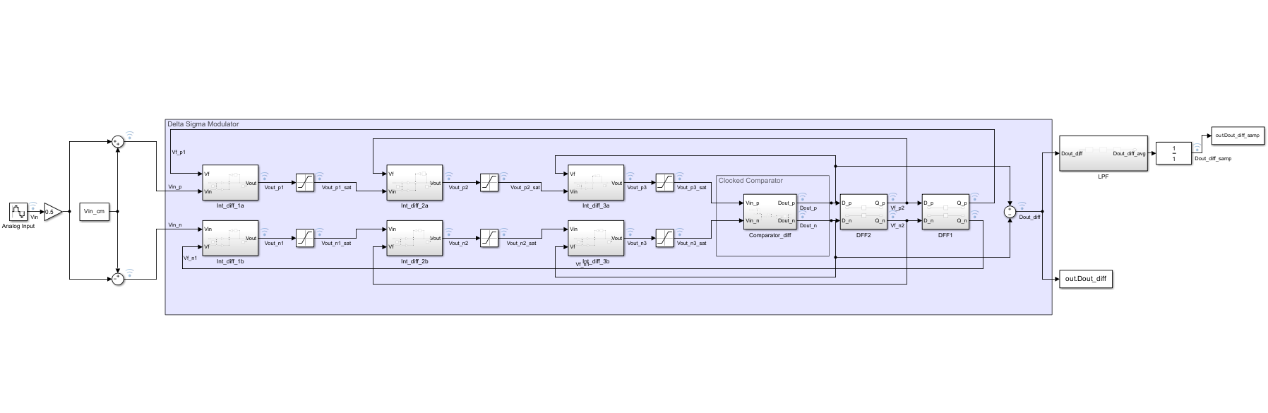
Modulator Simulink Model

Slide 16
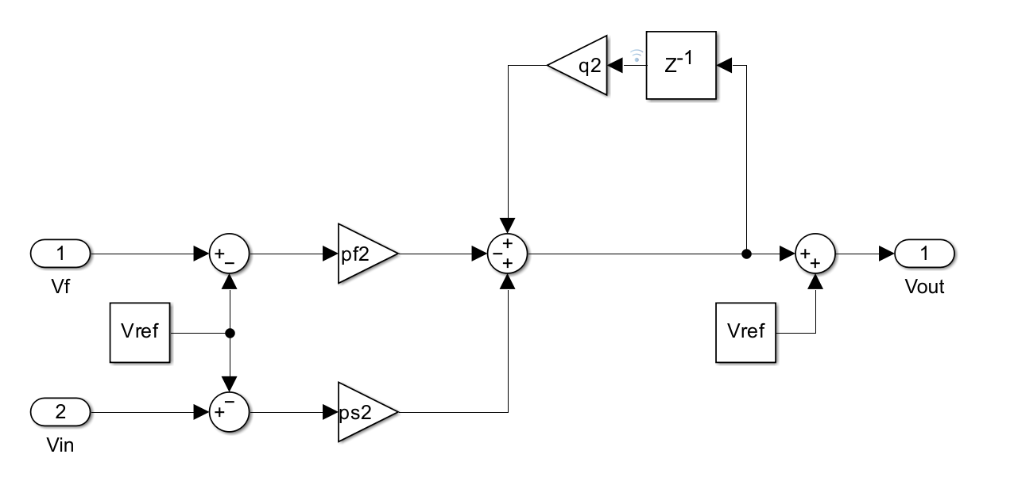
Loop Filter Simulink Model

Slide 17
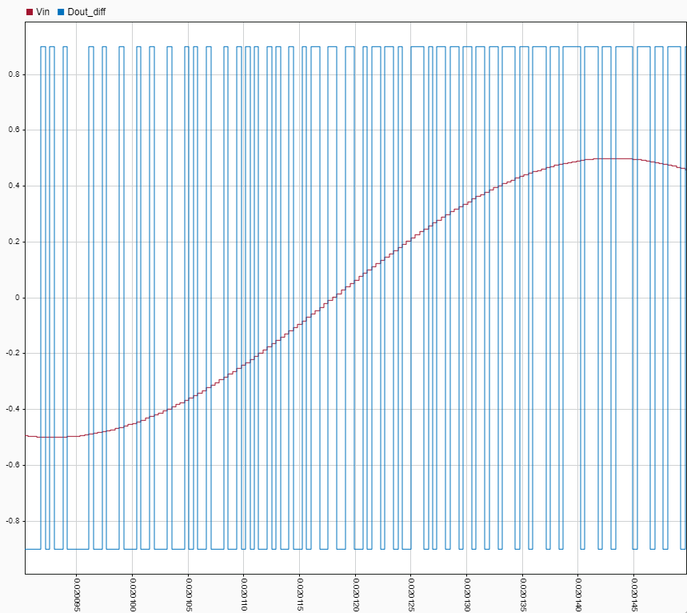
Loop Filter Simulink Model

Slide 18
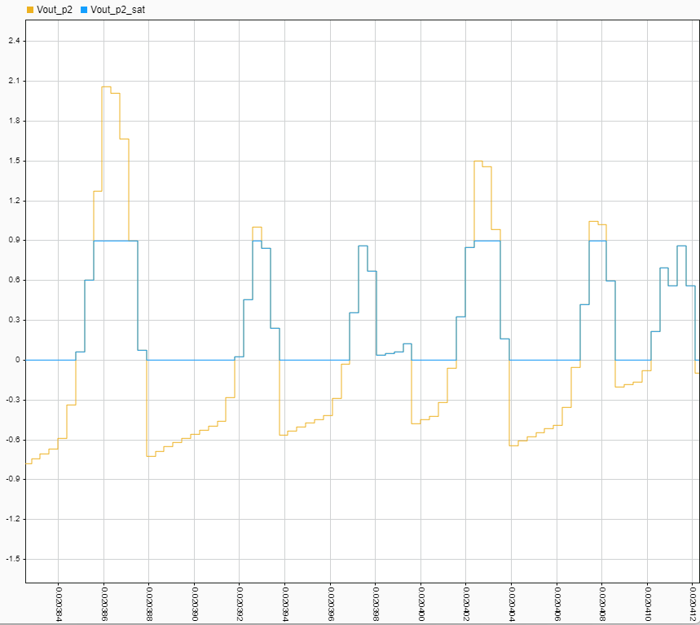
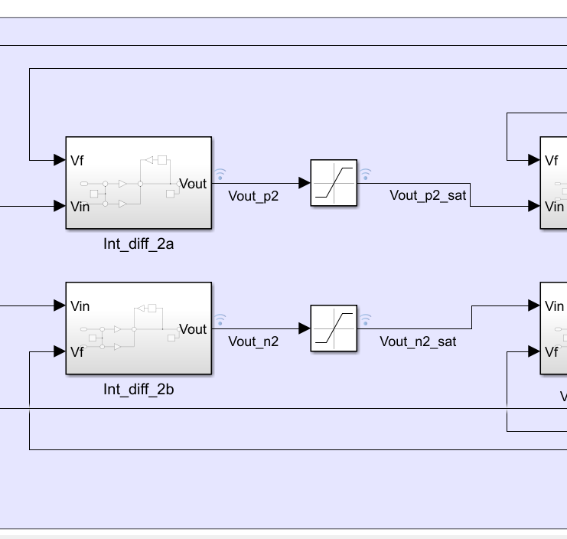
Loop Filter Gains Effect

Slide 19
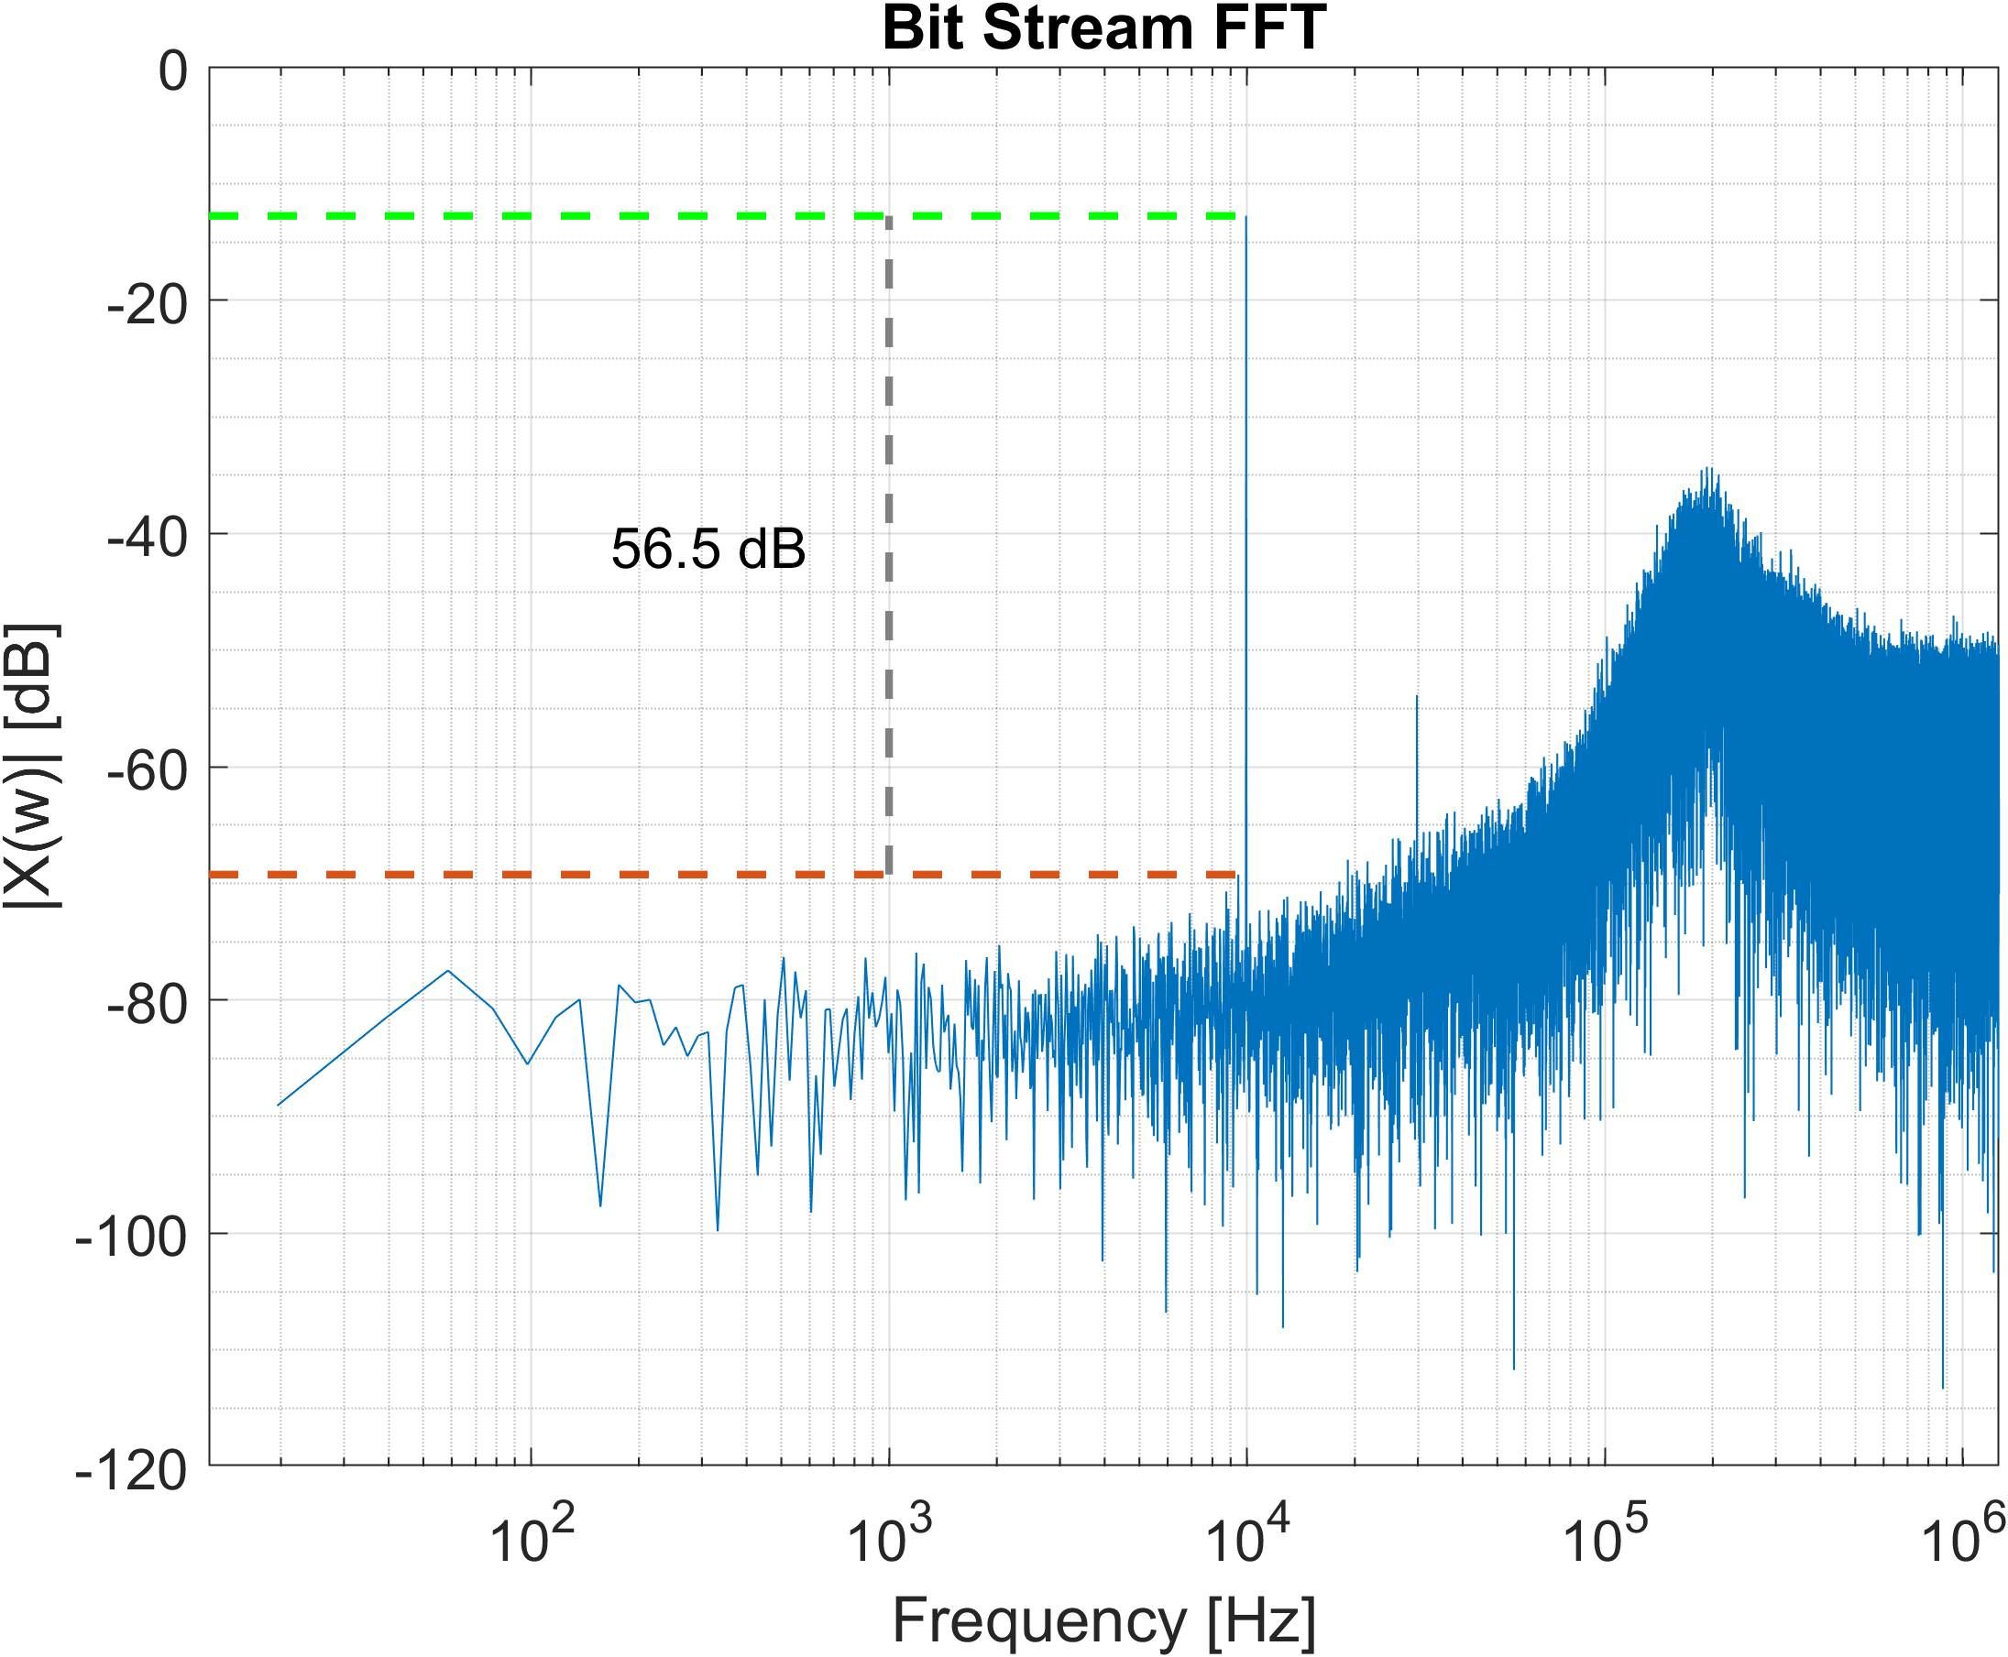
Loop Filter Gains Effect
Notes:
SNR = 6.02*N + 1.76

Slide 20
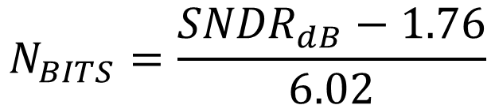
Loop Filter Gains Effect
$$N_{BITS}=\frac{{SNDR}_{dB}−1.76}{6.02}$$
Notes:
SNR = 6.02*N + 1.76

Slide 21
Outline
Delta-Sigma Modulator Context.
Simulink Modeling.
Optimization Results.

Slide 22
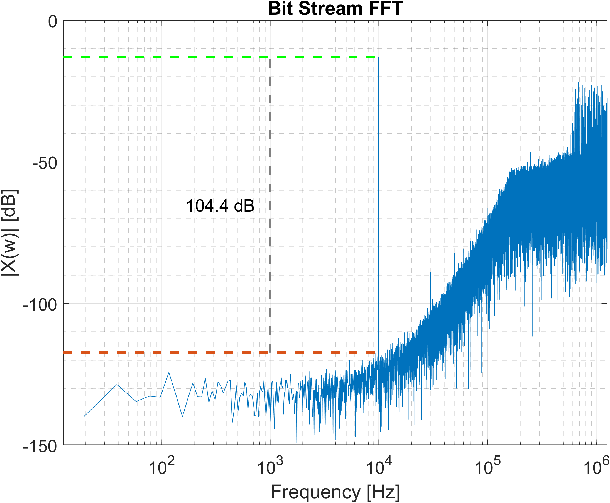
Levenberg Marquadt Method Result

Slide 23
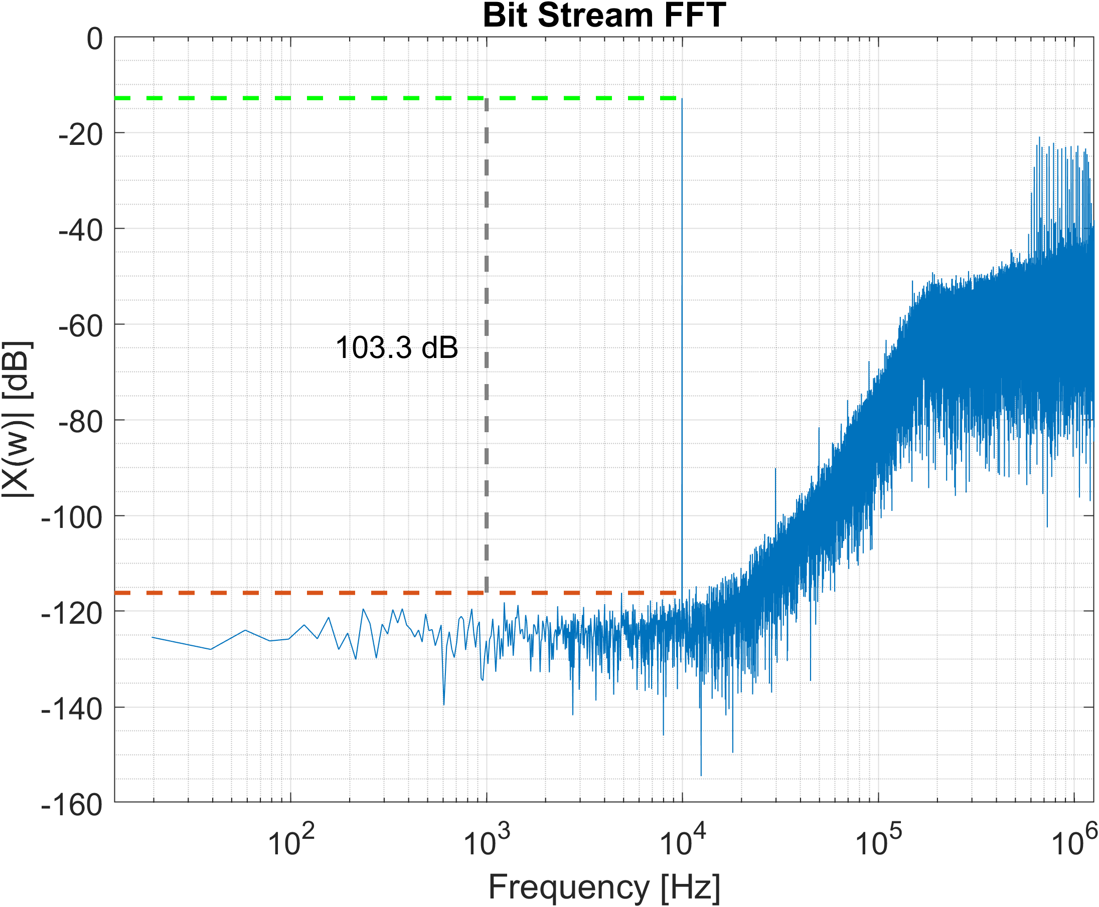
Adam Method Result

Slide 24
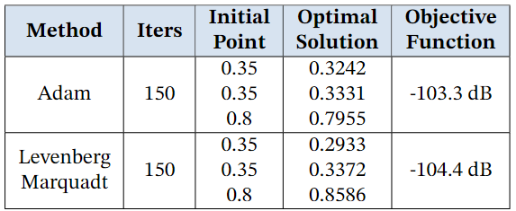
Adam Method Result

Slide 25

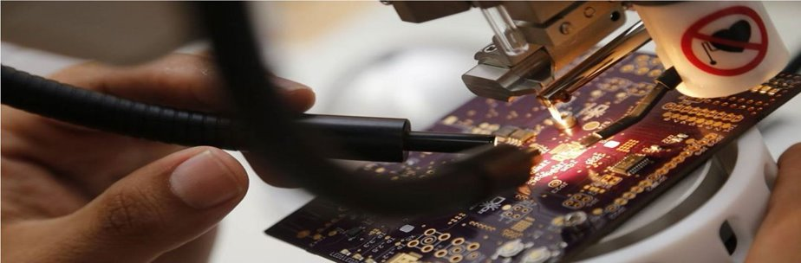

Thanks!
@onchipUIS
alex2248099@correo.uis.edu.co

